Slide 1

Rockbuster Data Results
Data Analyst
Raul Gabriel Torres

Slide 2
Key Questions
Which movies contributed the most/least to revenue gain?
What was the average rental duration for all videos?
Which countries are Rockbuster customer based in?
Where are customers with a high lifetime value based?
Do sales figures vary between geographic regions?

Slide 3
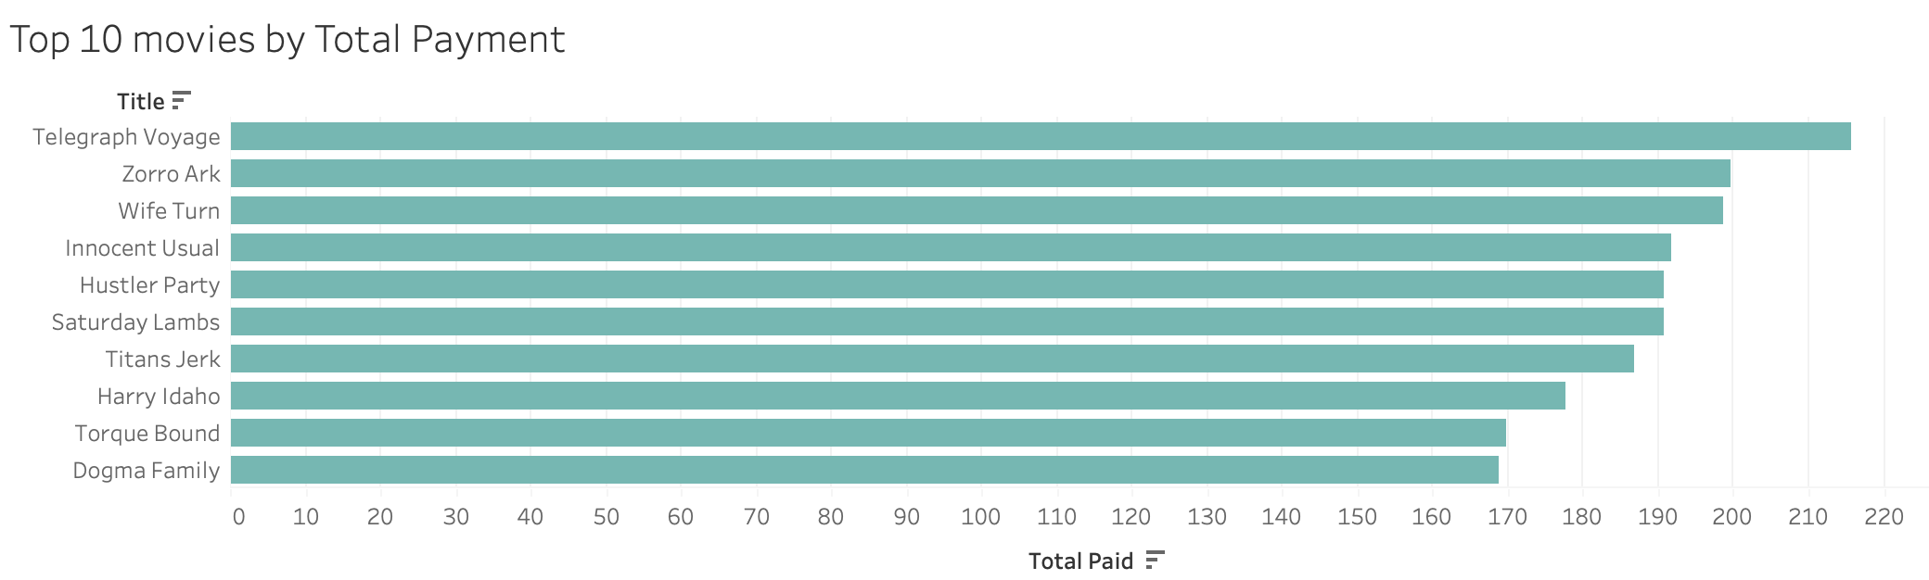
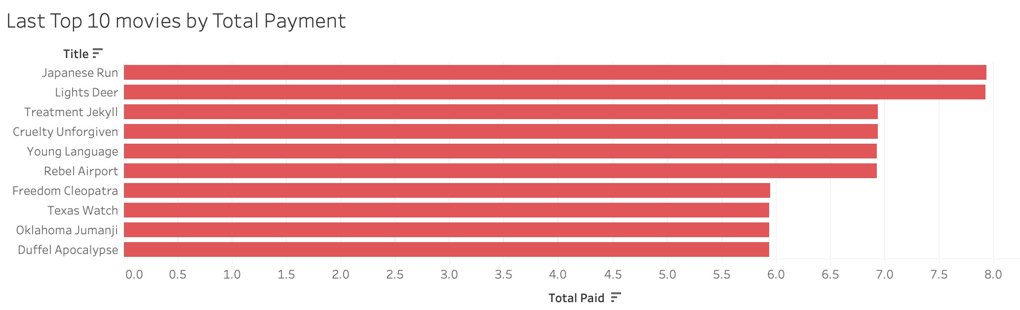
Which movies contributed the most/least to revenue gain?

Slide 4

What was the average rental duration for all videos?
Rental Duration by Movie:
Maximum: 7
Minimum: 3
Average: 4.99
Rental Duration by Customer:
Maximum: 233
Minimum: 50
Average: 132.20
Rental Duration by Customer:
Maximum: 7,757
Minimum: 89
Average: 733.19

Slide 5
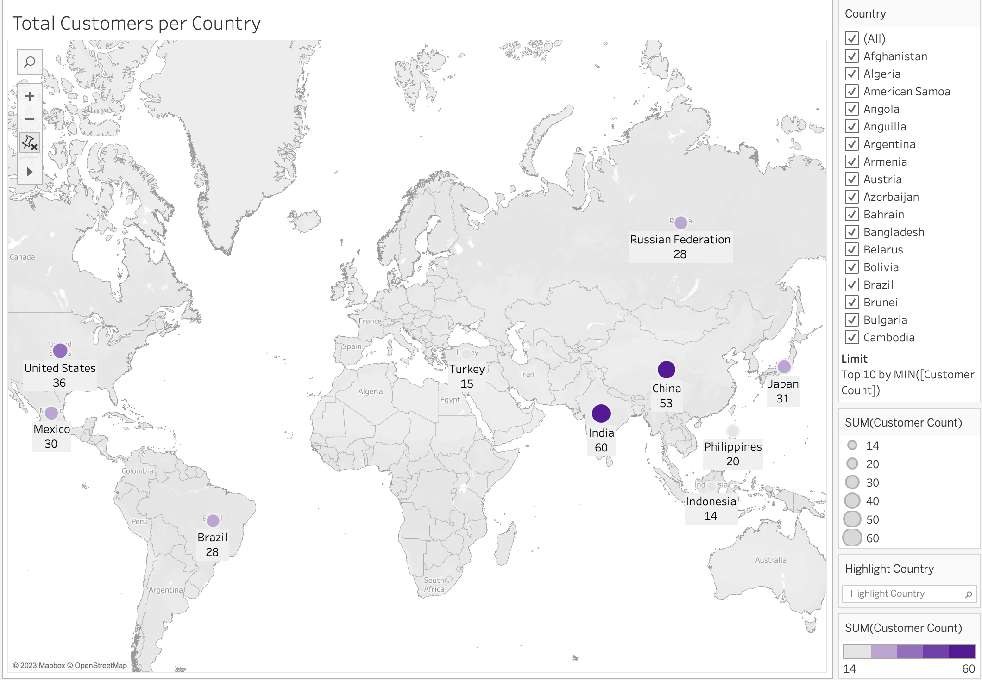
Which countries are Rockbuster customer based in? Do sales figures vary between geographic regions?

Slide 6
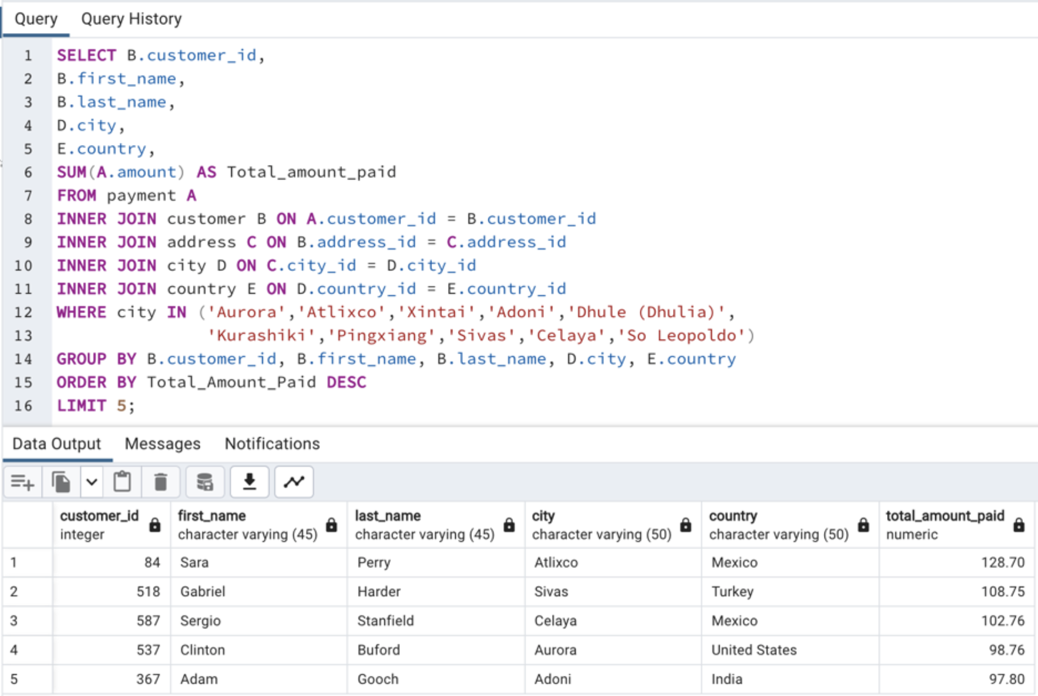
Where are customers with a high lifetime value based?

